Slide 1
Computer Graphics
Day III

Slide 2
Working in Screen/Pixel Space
Pros
Cons
1 unit = 1 pixel, distance is easy to understand.
Working with 2D sprites is straightforward.
You can operate completely in whole numbers if you want to.
A direct representation of what you see.
The raster has no Z it is completely 2D.
Y is going “down” instead of “up” unlike most mathematical Cartesian representations.
Translating or rotating vector shapes using integers alone could cause significant errors and information loss.
Everything is resolution dependent!
Insufficient information available to represent a fully 3D environment.

Slide 3
Working in 3D Space
Pros
Cons
A virtual 3D representation of all the things you “could” see!
Full 3D Rotation, Translation and Scaling is possible without truncation errors!
1 unit = Whatever you want as long as you are consistent! (feet, meters, yards…)
Independent of 2D raster resolution!
Not as direct when working in 2D alone.
Requires Rasterization: The conversion of vector coordinates to raster coordinates so shapes can actually be drawn.
More complex to understand.

Slide 4
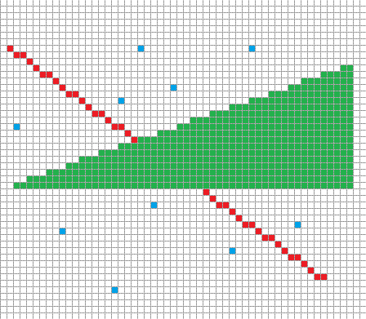
Rasterization

Slide 5
The Screen in 3D Normalized Device Coordinates
+1Y
+1Z
A.K.A The Canonical View Volume.
This coordinate system is always the same regardless of what you set your screen pixel width & height.
Notice how the origin is now in the center and that we have a Z axis available.
As we start to work in 3D this system will be much easier to deal with.
-1X
+1X
-1Z
-1Y

Slide 6

Exercise: Coordinate Conversion
+1Y
Width 6 pixels
*
XYZ
( -0.3,+0.7 +0.3 )
+1Z
X1 Y1 ( 2.1, 0.9 )
-1X
+1X
Height 6 pixels
XYZ
( +0.4,-0.6 ,-0.3 )
X2 Y2 ( 4.2, 4.89 )
-1Z
1
3
-1Y
*Add +0.5 to round to pixel centers

Slide 7
Using 3D to Our Advantage
We will learn many ways to take advantage of this new system.
To start we will need a better way to represent a location in this space.
A “Vertex” representing where two edges meet will be very convenient.
Coding Tip: struct VERTEX { float xyzw[4]; uint color; }
We won’t really capitalize on the Z or W today, but they will be useful later…
Once our shapes are stored in this 3D Space, it will be easier for us to rotate them around the screen center. (now the origin)

Slide 8
Review: 3x3 Rotation Matrices
Identity
[
1, 0, 0,
0, 1, 0,
0, 0, 1, ]
X Rotation
[
1, 0, 0,
0, cosθ, -sinθ,
0, sinθ, cosθ,
]
Y Rotation
[
cosθ, 0, sinθ,
0, 1, 0,
-sinθ, 0, cosθ,
]
Z Rotation
[
cosθ, -sinθ, 0,
sinθ, cosθ, 0,
0, 0, 1,
]
Vector3
[
X,
Y,
Z,
]
Matrix3x3
[
A, B, C,
D, E, F,
G, H, I,
]
Vector3
[
XA + YD + ZG,
XB + YE + ZH,
XC + YF + ZI,
]
Notes:
Discuss different terms, Square, Orthogonal, Orthonormal, Affine
Square : Equal number of rows and columns
Orthogonal: Perpendicular vectors
Orthonormal: Perpendicular and Unit Length vectors
Affine transformation preserves angles and lengths.

Slide 9
Adding Flexibility: Shaders
Currently if you draw a line… you draw EXACTLY that line…
Wouldn't it be useful to draw the same line in a different spot without having to remake it? What if we wanted to do this every frame?
What if multiple lines needed to move or rotate together as a group?
What if we wanted to temporarily draw the line a different color?
Perhaps our vector “spaceship” takes some damage and should flash red!
Shaders are customizable and “interchangeable” functions that intercept & modify data right before we draw it to the screen.

Slide 10
Shaders in Action!
FunctionPointer VertexShader
VS_SpinMe ( VERTEX V )
V = RotateVertex ( V, MATRIX M )
PS_Red ( COLOR C )
C = 0xFFFF0000
FunctionPointer PixelShader
DrawLine ( VERTEX A, VERTEX B )
CopyA = A
CopyB = B
VertexShader ( CopyA )
VertexShader ( CopyB )
CartesianToPixel ( CopyA )
CartesianToPixel ( CopyB )
…
FOR CopyA TO CopyB
DrawAPixel ( X, Y, Q )
DrawAPixel ( X, Y, COLOR Q )
Q = PixelShader ( Q )
FrameBuffer [ Y ][ X ] = Q
MainLoop
VERTEX MyLine[ 2 ]
VertexShader = VS_SpinMe
PixelShader = PS_Red
DrawLine ( MyLine [ 0 ], MyLine[ 1 ] )

Slide 11
Shaders.h
Rasterization_Functions.h
// The active vertex shader. Modifies an incoming vertex. Pre-Rasterization.
void (*VertexShader)( MY_VERTEX& ) = 0;
// The active pixel shader. Modifies an outgoing pixel. Post-Rasterization.
void (*PixelShader)( A_PIXEL& ) = 0;
// All Shader Variables (Always Pre-fixed by “SV_”)
MY_MATRIX_3X3 SV_WorldMatrix;
// Various custom vertex and pixel shaders, (Pre-fixed by “VS_” & “PS_”)
// Can be swapped using above function pointers as needed for flexibility.
// Applys the current world matrix to all
void VS_World( MY_VERTEX &multiplyMe )
{
MultiplyVertexByMatrix( multiplyMe, SV_WorldMatrix );
}
// Basic pixel shader returns the color white
void PS_White( A_PIXEL &makeWhite)
{
makeWhite = 0xFFFFFFFF;
}
// Draws a line using one of the line equations.
void DrawLine( const MY_VERTEX &start, const MY_VERTEX &end )
{
// Copy input data and send through shaders
MY_VERTEX copy_start = start;
MY_VERTEX copy_end = end;
// Use vertex shader to modify incoming copies only.
if ( VertexShader )
{
VertexShader( copy_start );
VertexShader( copy_end );
}
// original plotting variables adapted to use new cartesian data
SCREEN_XY screen_start = CartesianToScreen( copy_start );
SCREEN_XY screen_end = CartesianToScreen( copy_end );
// Standard line drawing code follows using integer coordinates...
for( numPixels )
{
A_PIXEL copyColor = currColor; // Just like a Vertex, copy original.
if ( PixelShader ) PixelShader( copyColor ); // Modify copy.
PlotPixel( currX, currY, copyColor ); // Display the copy.
}
}
Main.cpp
// Main program loop.
void main( void )
{
// Initialize constant drawing data. (BE SURE IT IS CONSTANT!!!)
const MY_VERTEX UnEditableOriginalLine[ 2 ] =
{
{ -0.5, +0.5 }, { +0.5, -0.5 } // Defines a fixed diagonal line crossing the origin.
};
// Enter the main drawing loop...
while ( Am_Drawing )
{
// Select appropriate Shaders you want to Use. REMEMBER! You can make as many as you want!
// Only ever having one type of shader defeats the purpose! (This exists for flexibility!)
VertexShader = VS_World; // I choose a shader that will multiply by a single matrix that I control.
PixelShader = PS_White; // Regardless of the original color I want all pixels to be shown white.
// Set any custom variables used by the shader functions so you can control shader behaviors directly!
SV_WorldMatrix = BuidRotationMatrixOnAxisZ( GetIncreasingRadiansOverTime() );
// With appropriate shaders chosen we draw the fixed line. (A copy will be modifed by shaders)
DrawLine( UnEditableOriginalLine[ 0 ], UnEditableOriginalLine[ 1 ] );
}
// Exit program...
}

Slide 12

Drawing Filled Triangles
+1Y
+1Z
XYZ
XY
?
-1X
+1X
XYZ
XY
XYZ
XY
-1Z
-1Y

Slide 13
Triangle Rasterization
The last type of primitive we will learn to draw on the 2D raster grid is going to be the triangle.
However, we will define them in our new 3D coordinate system.
Triangles can be connected together to form every other type of polygon, which makes them very versatile.
Nearly everything you see in a modern game or simulation is comprised of triangles.
Your current knowledge would allow you to draw the “outline” of a triangle, but not much else.
In order to “fill” a triangle with pixels, we will need to dig deeper into the math behind triangles, and how the space within a triangle is defined.

Slide 14
Review: Triangle Basics
C
SOH
a² + b² = c²
γ
CAH
α + β + γ = 180º
a
TOA
h
b
perimeter = a + b + c
β
area = ½ hc
B
c
α
A

Slide 15
Barycentric Coordinates
Defines a Non-Orthogonal coordinate system describing the space of a triangle.
Any position on this plane can be described with the following equation:
P = β( B – A ) + γ( C – A ) + A
Terms Reordered:
P = ( 1 - β - γ )A + β( B ) + γ( C )
α = ( 1 - β - γ )
P ( α, β, γ ) = αA + βB + γC
+γ
C
-β
P ( +0.4β, +1.3γ )
-γ
A
B
+β

Slide 16
Barycentric Coordinates == 3 Gradient Ratios
( 0β, 1γ, 0α )
1
1
β
α
( 1β, 0γ, 0α )
( 0β, 0γ, 1α )
1
0
0
γ
0

Slide 17
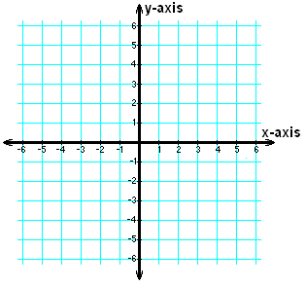
Finding the Barycentric Coordinates of a point relative to a triangle
A
β = ImplicitLineEquation ( B, line AC )
γ = ImplicitLineEquation ( C, line BA )
α = ImplicitLineEquation ( A, line CB )
b = ImplicitLineEquation ( P, line AC )
y = ImplicitLineEquation ( P, line BA )
a = ImplicitLineEquation ( P, line CB )
P_{βγα} = ( b / β , y / γ, a / α )
Could we use the Barycentric coordinates to detect if we are inside or outside the triangle? If so… how?
α
b
y
β
P
B
γ
a
C

Slide 18
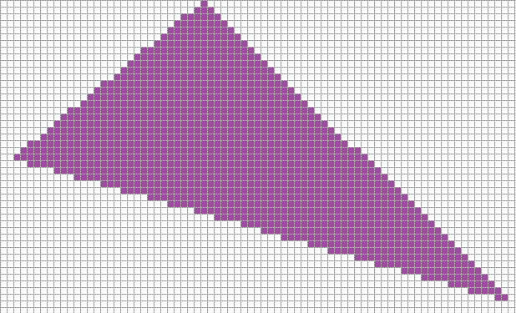
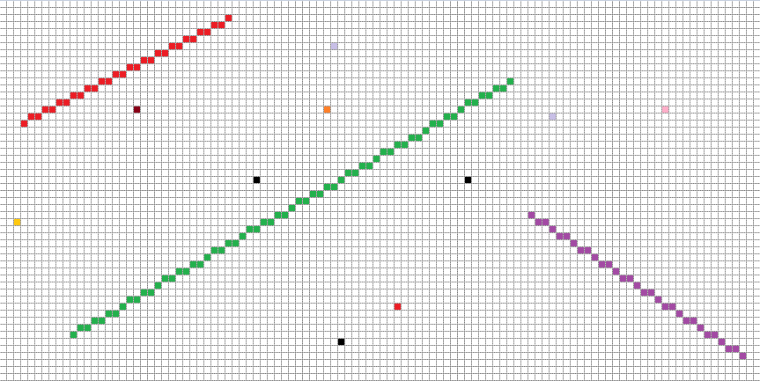
Triangle Drawing Algorithms
Positive X Axis
(0,0)
(1,0)
(2,0)
(0,1)
(1,1)
(2,1)
Positive Y Axis
(0,2)
(1,2)
(2,2)

Slide 19
Brute Triangle
X1, Y1
FOR ALL PIXELS
bya = FindBarycentric ( CurrX, CurrY )
IF b >=0 && b <= 1 &&
y >=0 && y <= 1 &&
a >=0 && a <= 1
THEN
PlotPixel ( CurrX, CurrY )
X3, Y3
X2, Y2

Slide 20
Better Brute Triangle
X1, Y1
StartX = MIN ( X1, X2, X3 )
StartY = MIN ( Y1, Y2, Y3 )
EndX = MAX ( X1, X2, X3 )
EndY = MAX ( Y1, Y2, Y3 )
FOR StartY to EndY
FOR StartX to EndX
bya = FindBarycentric ( CurrX, CurrY )
IF b >=0 && b <= 1 &&
y >=0 && y <= 1 &&
a >=0 && a <= 1
THEN
PlotPixel ( CurrX, CurrY )
X3, Y3
X2, Y2

Slide 21
Lari’s Parametric Triangle
Top
X1, Y1
Step 1: Sort the VERTS in Y Ascending.
Step 2: Determine the “Direction of Fill” by comparing the Middle vertex to the opposite line. (Use the Implicit Line Equation)
Step 3: Use the Parametric Line Equation to find the closest staring pixel for each row on the tallest line. (Top to Bottom)
Step 4: Determine if the Pixel’s center is within the Barycentric space of the triangle. If it is you should Draw that pixel.
Step 5: Continue drawing pixels on that row until you leave Barycentric space. (Ignore any pixels below the parametric line)
X3, Y3
Middle
Bottom
X2, Y2
Direction Of Fill
My personal take on rasterizing a triangle. From what I have seen this is similar to an “edge-walking” approach but with no special cases.

Slide 22
Barycentric Interpolation
Surprise! Barycentric coordinates are ALREADY ratios that add up to 1
Linear Interpolation: X = ( B – A ) * R + A
Linear written another way: X = ( B * R ) + A * ( 1 – R )
1.0 = β + γ + α So…
Barycentric Interpolation: X = A * α + B * β + C * γ
Well that was easy! =)

Slide 23
Applicable Reading Assignment
For next time read:
In Chapter 5 Linear Algebra:
Read sections 5.1, 5.3
In Chapter 6 Transformation Matrices
Read sections 6.3 – 6.5
In Chapter 7 Viewing:
Read sections 7.1 – 7.5

